Slide 1
Explain The Effect Of Illumination On Image Formation,defining Realworld Challenges,using Graphical tools

Slide 2
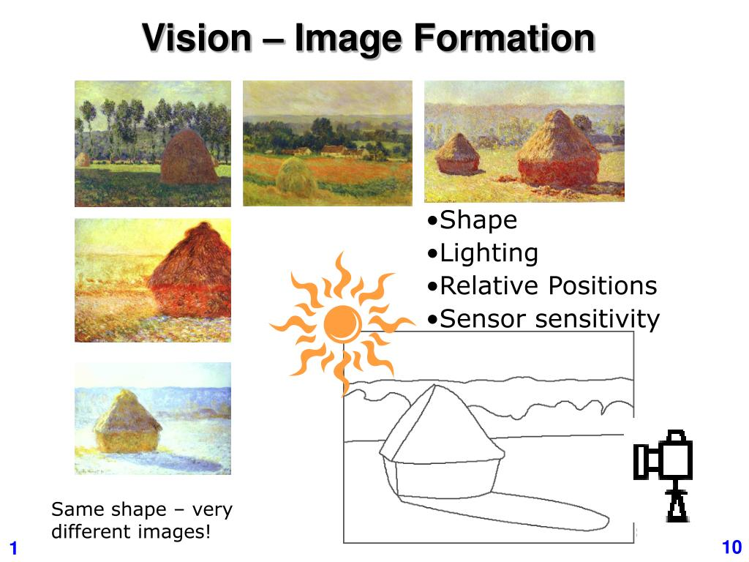
Introduction to Illumination in Image Formation
Illumination plays a crucial role in how images are captured and perceived.
Variations in light intensity and source significantly affect image quality and details.
Understanding these effects helps improve imaging systems and address real-world challenges.
Notes:
Image source: https://image3.slideserve.com

Slide 3
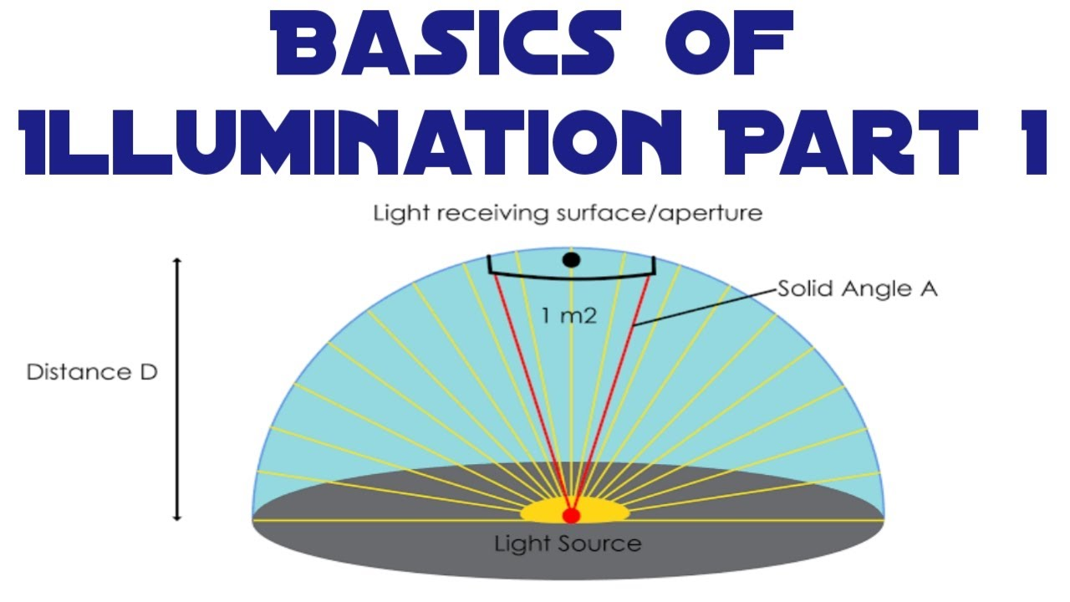
Basics of Light and Illumination
Light can be natural (sunlight) or artificial (lamps, LEDs).
The quality of illumination influences contrast, color, and visibility in images.
Proper lighting conditions are essential for accurate image representation.
Notes:
Image source: https://i.ytimg.com

Slide 4
How Illumination Affects Image Formation
Illumination impacts the brightness and shadows in an image.
Uneven lighting can cause overexposed or underexposed regions.
Consistent and uniform lighting produces clearer and more detailed images.
Notes:
Image source: https://i.ytimg.com

Slide 5
Real-World Challenge: Variable Lighting Conditions
Outdoor environments experience changing light due to weather and time of day.
Indoor settings may have inconsistent artificial lighting.
These variations make it difficult for imaging systems to maintain accuracy.
Notes:
Image source: https://www.frontiersin.org

Slide 6
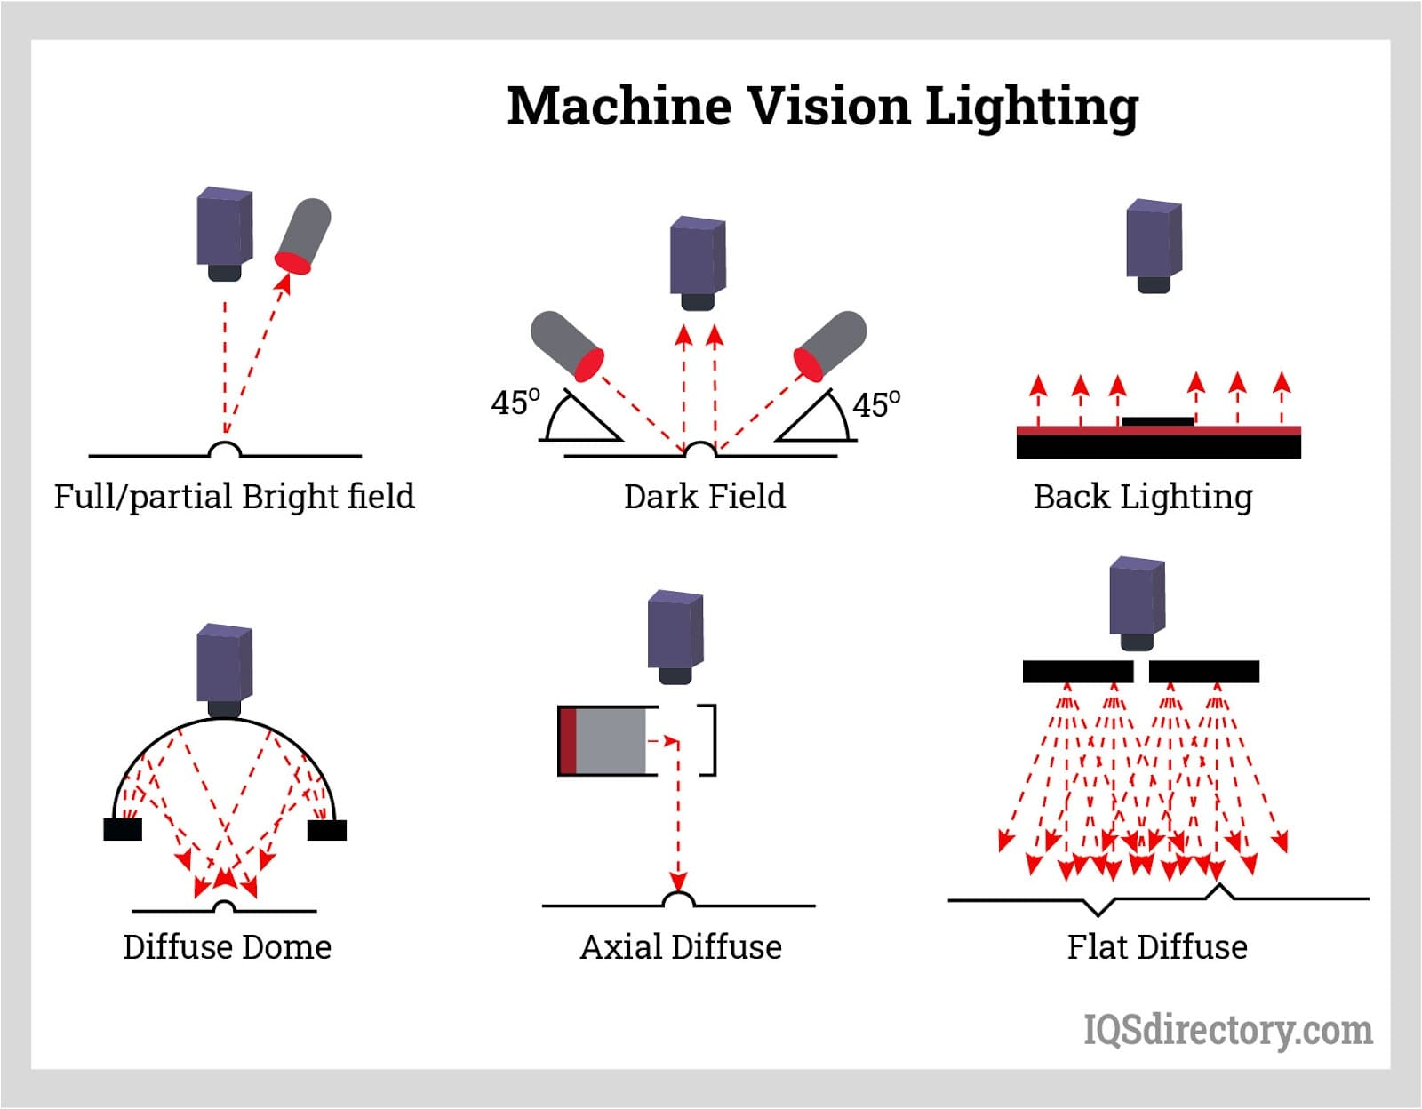
Impact on Image Quality and Recognition
Poor illumination causes noise and reduces the visibility of important features.
It hampers automated systems like facial recognition or object detection.
Enhancing illumination or compensating for its effects is critical for reliable imaging.
Notes:
Image source: https://www.iqsdirectory.com

Slide 7
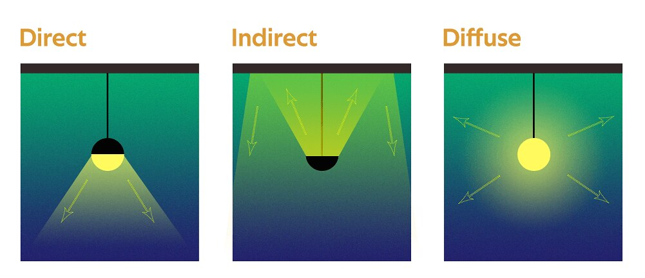
Graphical Illustration of Lighting Effects
(Include a diagram showing an object under different lighting conditions: bright, dim, side-lit, and backlit.)
The illustration highlights variations in shadows, highlights, and detail visibility.
It demonstrates how light direction and intensity alter the perceived image.
Notes:
Image source: https://lh7-us.googleusercontent.com

Slide 8
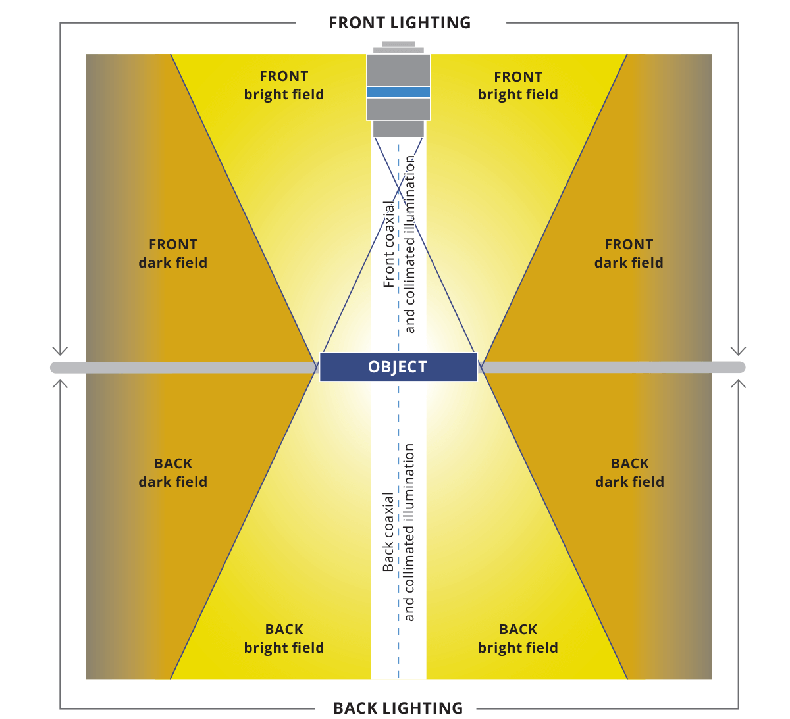
Techniques to Mitigate Illumination Challenges
Use of image processing algorithms like histogram equalization improves visibility.
Adaptive lighting setups and controlled environments reduce variability.
Hardware solutions include adjustable light sources and sensors that adapt to ambient light.
Notes:
Image source: https://www.opto-e.com

Slide 9
Case Study: Low-Light Imaging Challenges
Low-light conditions often produce noisy, blurry images with poor detail.
Nighttime surveillance and medical imaging face significant illumination issues.
Solutions involve specialized sensors, infrared illumination, and post-processing algorithms.
Notes:
Image source: https://www.mdpi.com

Slide 10
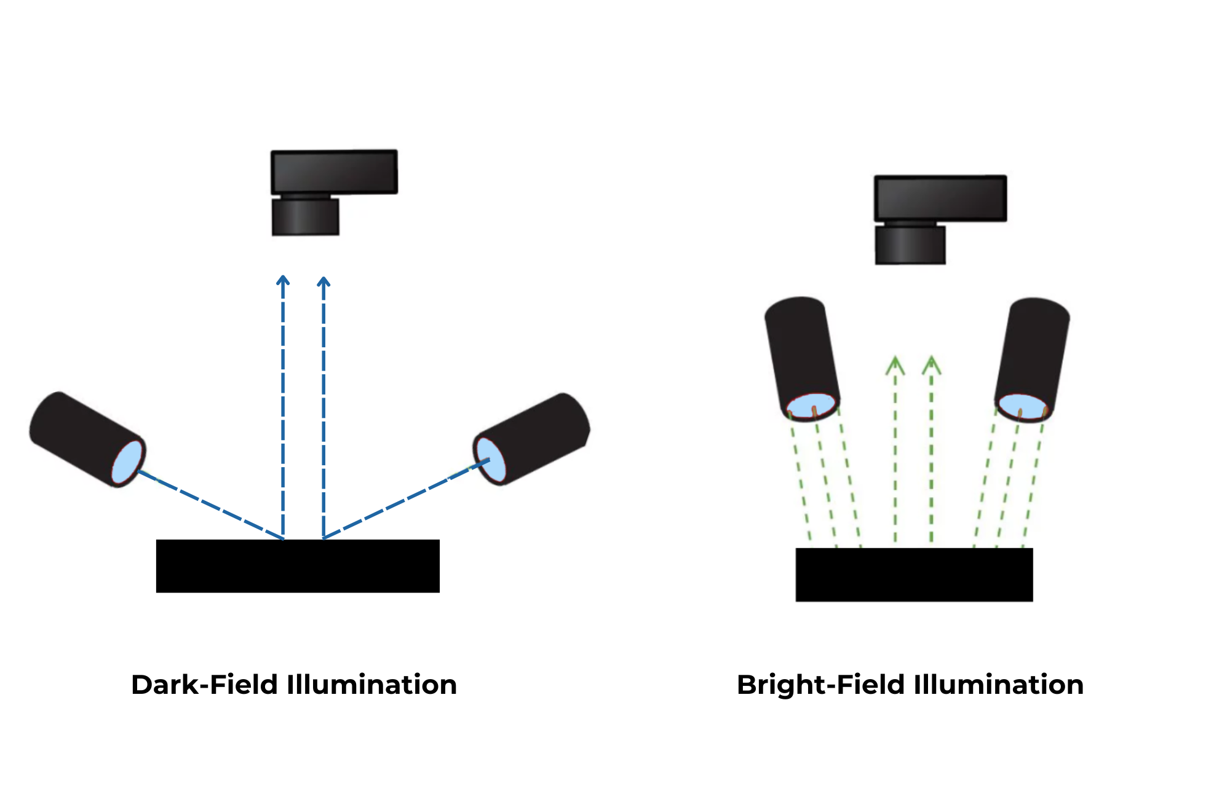
Future Directions in Illumination Adaptation
Developing intelligent systems that dynamically adjust lighting based on scene analysis.
Integration of AI-powered illumination compensation techniques for real-time correction.
Advanced sensor technology to capture high-quality images in diverse lighting conditions.
Notes:
Image source: https://intelgic.com

Slide 11
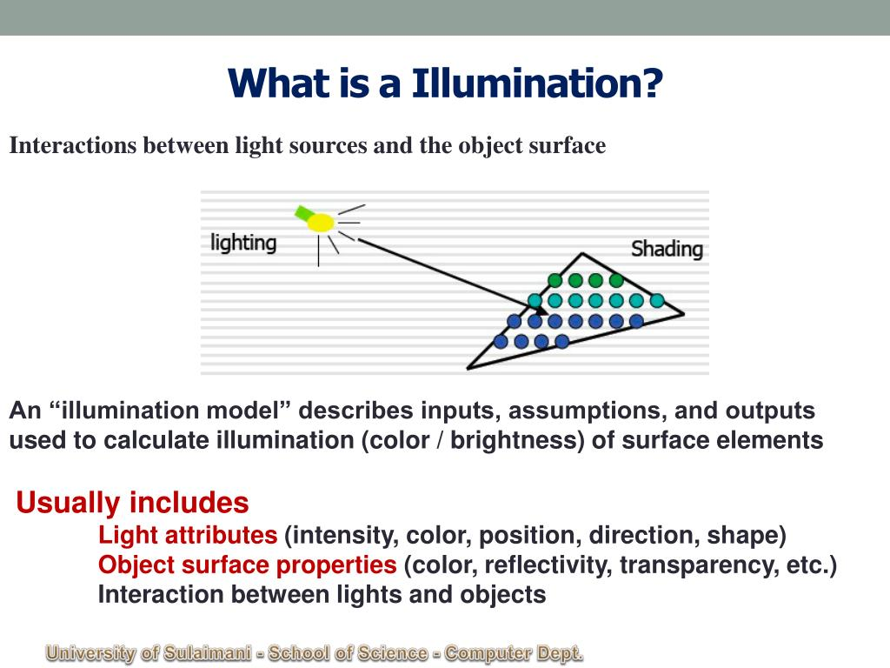
Conclusion and Summary
Illumination profoundly influences the quality and accuracy of image formation.
Addressing real-world illumination challenges is essential for reliable imaging systems.
Ongoing technological advancements continue to improve how we manage illumination effects.
Notes:
Image source: https://image1.slideserve.com

